Slide 1
Circular Linked List in C
Data Structures Implementation
Prof. Rohit Pal Singh

Slide 2
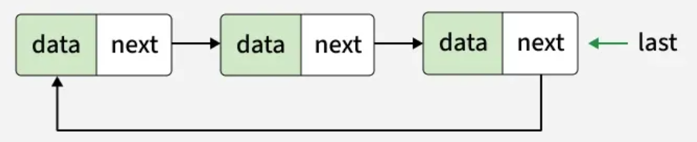
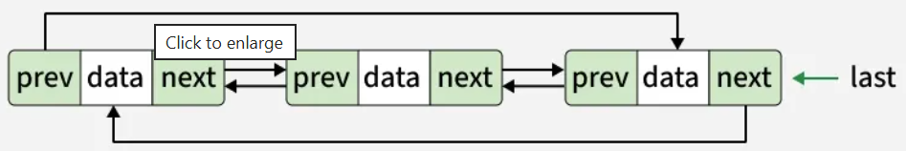
What is a Circular Linked List?
Definition:
  A linked list where the last node points back to the first node
  Forms a continuous circular structure
  No NULL pointers in the next field of the last node

Slide 3
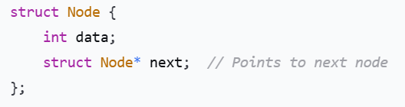
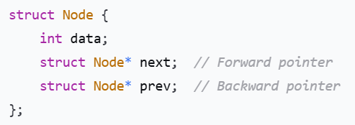
Node Structure in C
Types of Circular Linked Lists
  Singly Circular Linked List
  Doubly Circular Linked List

Slide 4
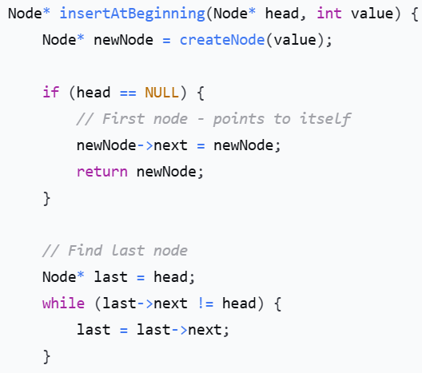

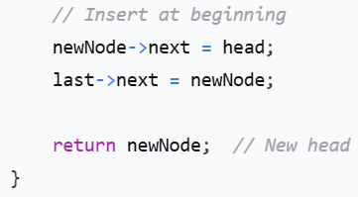
Insertion at Beginning

Slide 5
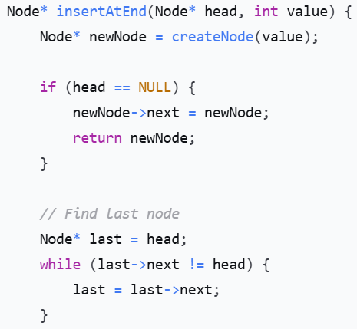
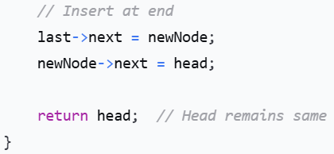
Insertion at End

Slide 6
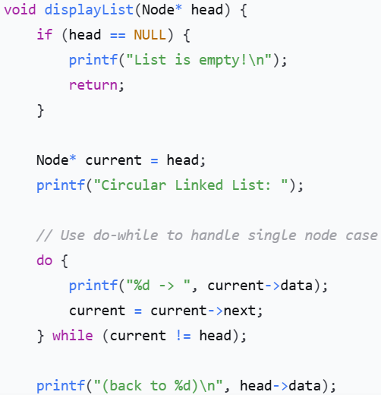
Traversal and Display

Slide 7
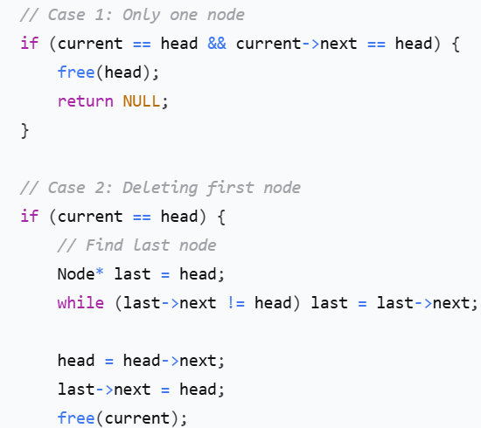
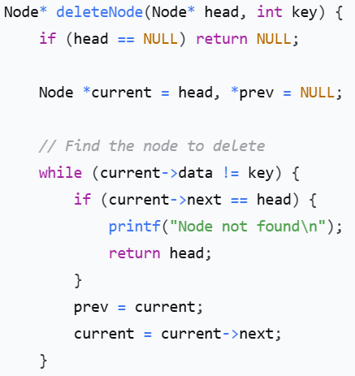
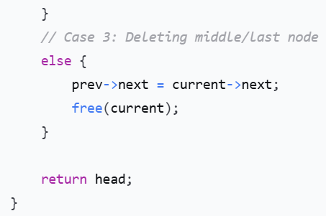
Delete Node

Slide 8
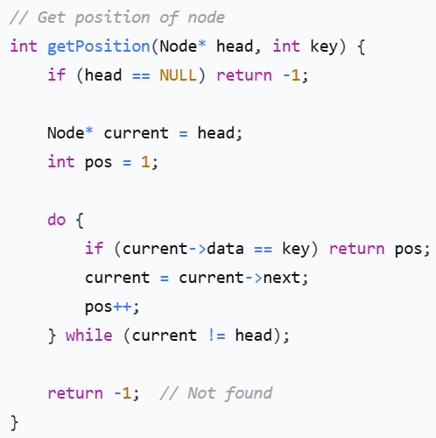
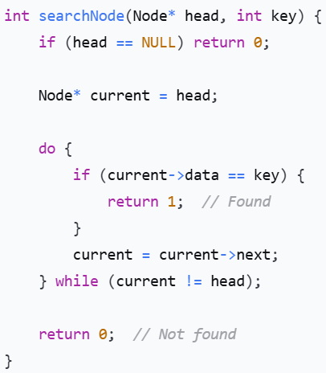
Searching in Circular List

Slide 9
Thanks

